Slide 1
The circular economy concept
Fyodor Malchik

Slide 2
The Circular Economy: Concept & Trends
Content
Economic Strategies
Concept & Principles
The Economic Potential
Jobs, Activities and the Social Dimension

Slide 3
Economic Strategies
80% thrown while huge needs

Slide 4
Concept & Principles

Slide 5
A Circular Economy
Preserve stock quality & manage flows
GDP (flow)
How we measure our economy today
Source: Giarini & Stahel, 1989
!
Level is ignored
Welfare / Wealth / Knowledge (stock)
How it should be measured!
Outflow is ignored
!

Slide 6
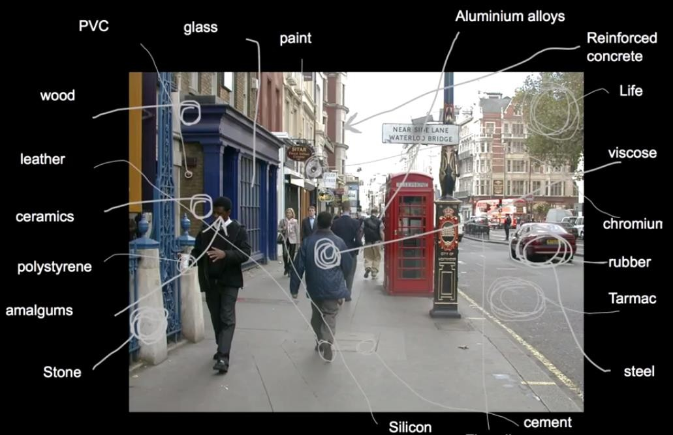
A Circular Economy
Stock is everywhere

Slide 7
A Circular Economy
A resource-efficient economy
Reuse of vast amount of material
=
Foundation of Economic Growth
Restorative by design & intention Using renewable energy
Away from chemicals Eradicating waste Rebuilding natural capital

Slide 8
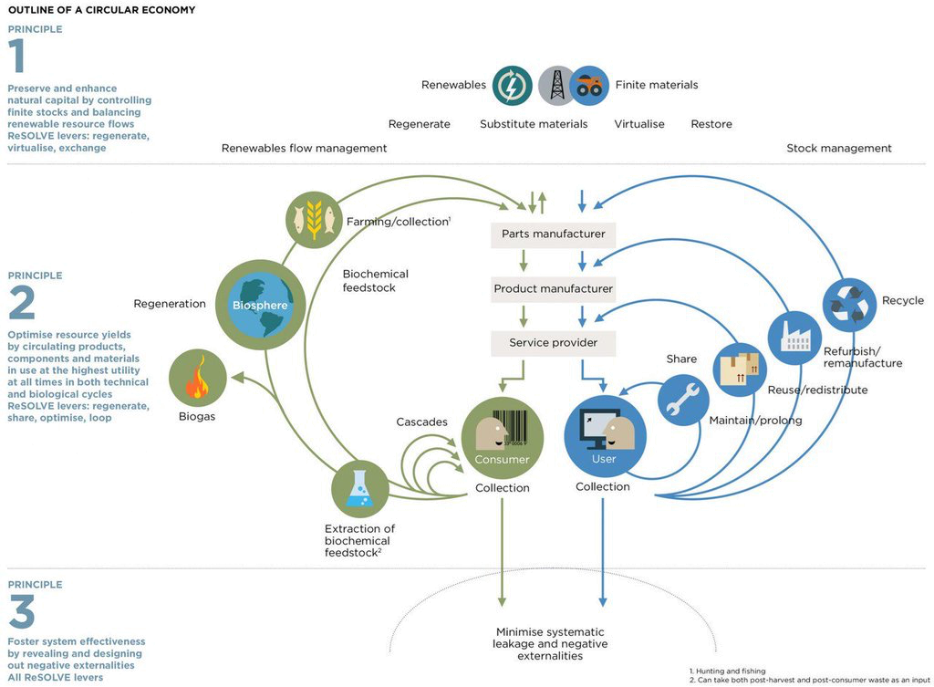
By 2030:
+3M EU Jobs
-520,000 Unempl.
By 2050:
$4.5tn WWD
Depending on countries: From -40% to
-70% less CO2
Rebuilding of
Capital:
In Priority: Natural
Source: The Ellen MacArthur Foundation/WRAP/WEF

Slide 9
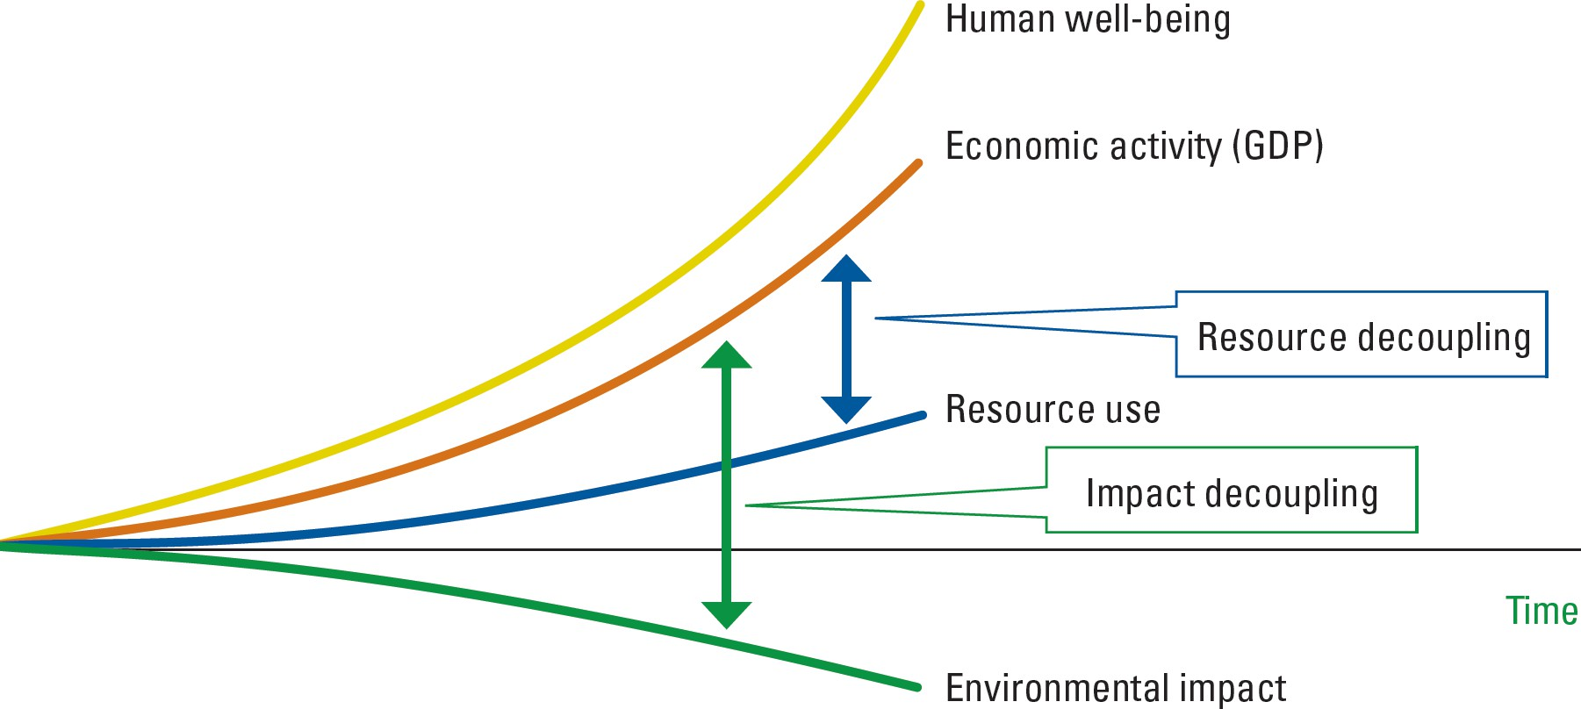
A Circular Economy
Decoupling is the Imperative
C.E. Business Models
+
New capabilities
+
New technologies
Leading to new value chains:
Less resource supply risks
More customer value creation
More attractive cost structures
Source: The UN Environment, Accenture

Slide 10
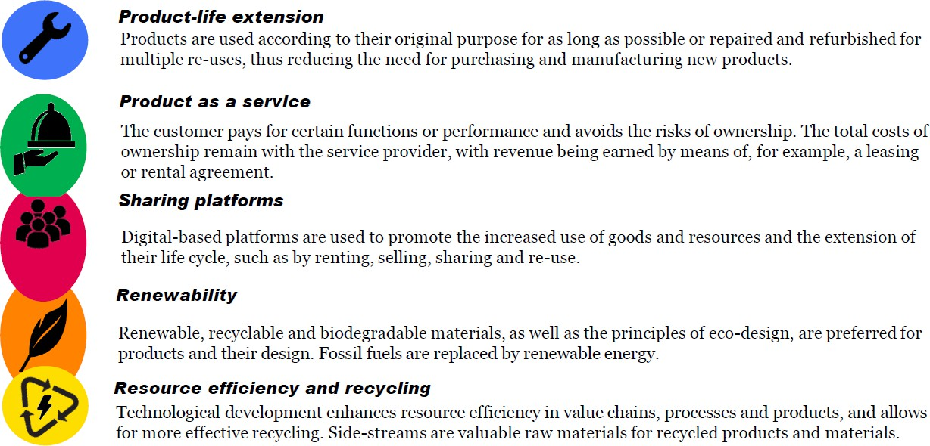
A Circular Economy
New Business Models
Source: Sitra

Slide 11
A Circular Economy
6 Business Strategies

Slide 12
A Circular Economy
Recycling is only the last resort
Reducing materials to mashed-up fragments
Down-cycling
Secondary material stream for a linear economy
Does not value materials
Does not drive material enhancement Uses too much energy
A good alternative solution today
Not a solution that copes with waste volumes

Slide 13
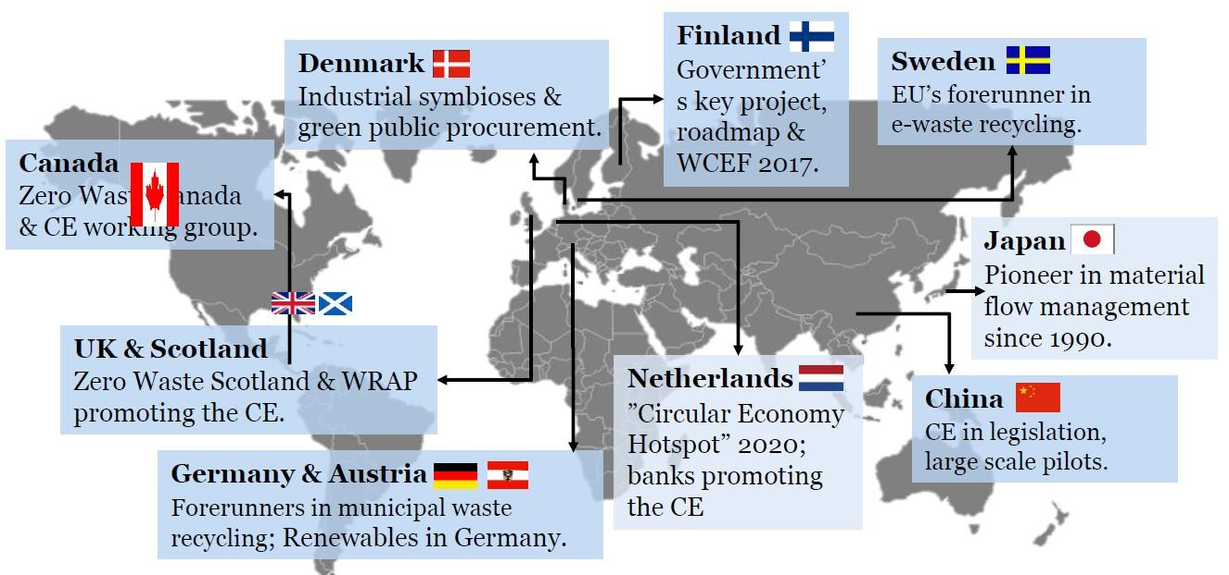
A Circular Economy
Advances across the Globe
Source: Sitra

Slide 14
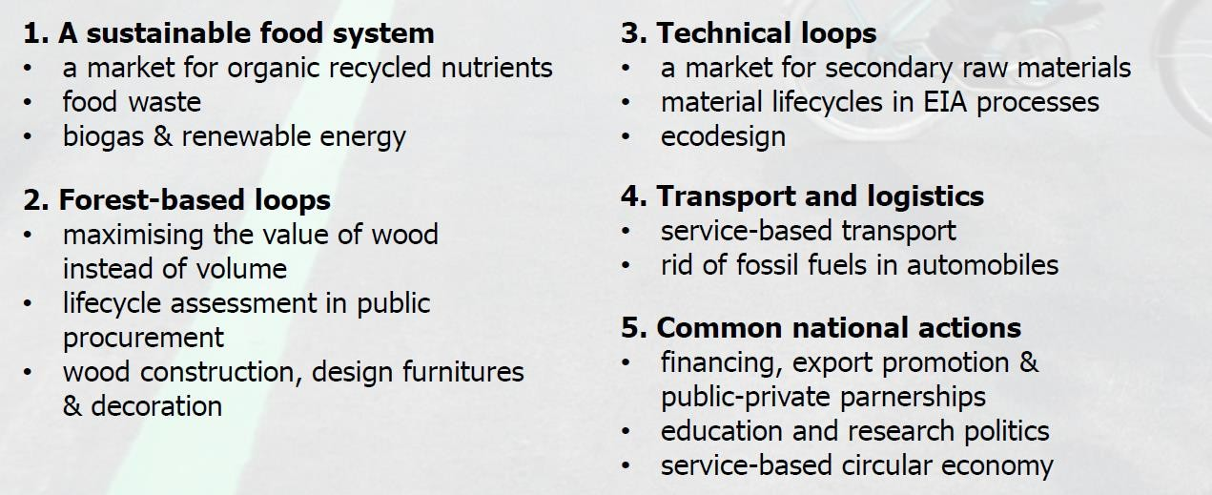
The Case of Finland
Examples: Policy Measures

Slide 15
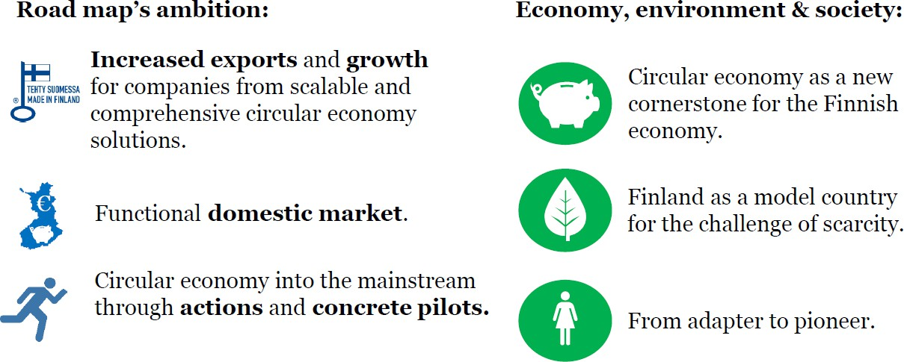
The Case of Finland
Takeaways & Expectations
Global Unique Roadmap
Government Vision: World Leader in Circular Economy Added Value Potential: 3bn Euros for the Economy Additional Jobs: 75,000 (Club of Rome)
Source: Sitra

Slide 16
Jobs, Activities & the Social Dimension

Slide 17
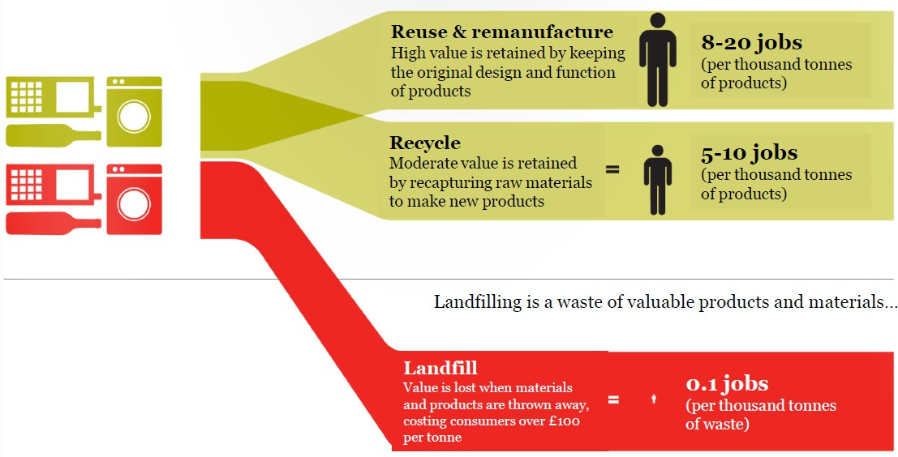
Jobs, Activities & the Social Dimension
Product Sold for Reuse & Remanufacture
Source: Green Alliance, Sitra

Slide 18
Jobs, Activities & the Social Dimension
Winners: jobs & climate
Decoupling Strategies:
Renewable Case
Energy-efficiency
Material- efficiency
All Three Combined
Up to 70% Less CO2 Emissions
Emission Reduction
+ + + +75,000 (FL);
+100,000 (SW);
+200,000 (NL);
+400,000 (SP);
+500,000 (FR);
-50%
Around -30%
-3% to -10%
-66% to -69%
Source: Club of Rome
Additional Jobs
+15,000 (FL);
+20,000 (SW);
+100,000 (NL);
+50,000 (SW+FL);
+15,000 (SW+FL);
+50,000 (NL);
+100,000 (NL);
+200,000 (SP);
+300,000 (FR);
+100,000 (FR+SP)
+ +
+
+200,000 (FR+SP)
Trade Balance Effects
+0.3% to +0.7%
of GDP
0% to +0.4%
of GDP
+1% to +2%
of GDP
+1.5% to +3%
of GDP

